Slide 1
Lead Scoring Assignment Presentation

Slide 2
Problem Statement and Objective
Problem Statement - An education company named X Education sells online courses to industry professionals. The company markets its courses on several websites and search engines like Google. Once these people land on the website, they might browse the courses or fill up a form for the course or watch some videos. When these people fill up a form providing their email address or phone number, they are classified to be a lead. The typical lead conversion rate at X education is around 30%.
Objective - The company requires you to build a model wherein you need to assign a lead score to each of the leads such that the customers with higher lead score have a higher conversion chance and the customers with lower lead score have a lower conversion chance. The target has given a ballpark of the target lead conversion rate to be around 80%.

Slide 3

Data Understanding
Lead data set which we received . The Lead data set has 37 variables and more than 9000 rows .
To find out the different segmentation , consideration of problem statement and objective, find out each variable significance and how “Converted” is dependent on different pattern, based on this formula we have find out segmentation.
Converted is the main variable which we can consider for analysis purpose , along with identified different segmented variables.
To understand the significance of each column and importance , data dictionary need to refer.
Multiple times we have visited to data set and problem statement to get the more insights from the data . We have identified the Correlation pattern.
While segmentation and defining the pattern , we take insights from the variables , which we will consider the same while our modeling purpose.

Slide 4
Data Cleaning and Manipulation
We have used the Jupyter Python notebook for data cleaning, data mining, modeling, visualization. We have imported the require libraries of Python . Main libraries are – Numpy,Pandas, Matplotlib,Seaborn, Sklearn, StandardScaler, Kmeans, silhouette_score, Scipy etc.
Check the basic things like – dimensions, info, null values in the data set etc.
We have analyzed the missing values and null values of each variable present in the data set. We found the missing and null values in multiple variables.
We have handled the missing values , and if column wouldn’t significance then we dropped too.
To handle the missing values for each column , we have continued with this till we would finalize some logical point.
During this process we have treat logical string, number for the variable values , those can not be handled during the feature recognition phase.

Slide 5
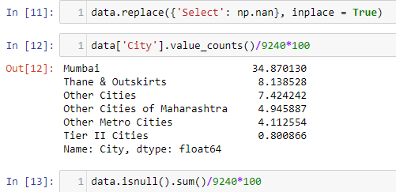
Data Cleaning and Manipulation
We have handled as below –
We have analyzed the variable which would have dependency
With each other action with regard to Converted variable. The variables which visualized with basic statistic techniques are – Country, Specialization,City,Tags, Lead Quality, What matters most to you in choosing a course, What is your current occupation, Asymmetrique Activity Index, Asymmetrique Profile Index , Last Activity, Page Views Per Visit, TotalVisits etc. Along with the check the indexing as well.
We have handled the variables and there values as per business parameters and inferences from statistics. As value represent the average ratio of the resulted values.
We have converted the numerical values into categorial variables . For example treat as – Yes/No replaces with 0 and 1.

Slide 6
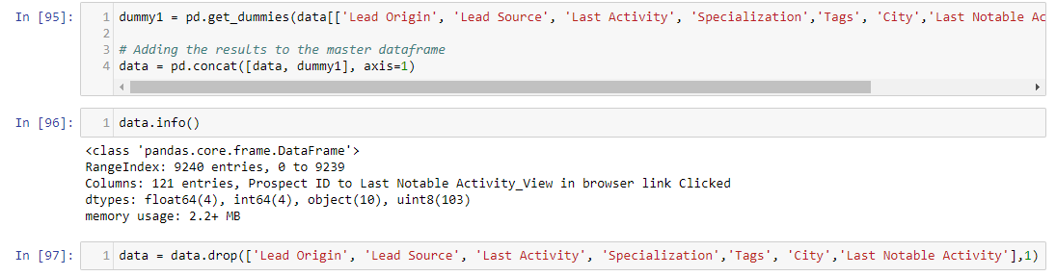
Data Cleaning and Manipulation
We have defined the selected dummy variable , concatenated them with original dataframe and then dropped original variables. The same handled in below code –
We have checked the data set with Prospect ID to validate the operations which we performed earlier , impacted on the data set or not , and the same is impacted as below -

Slide 7
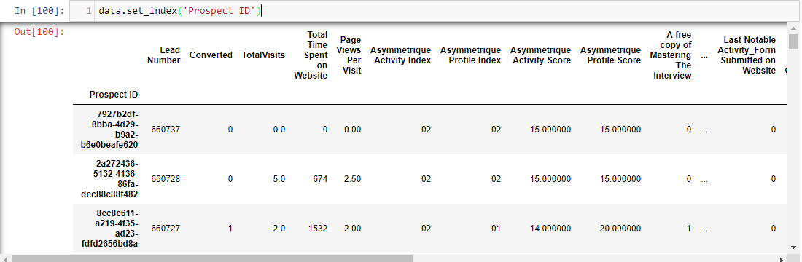
Data Cleaning and Manipulation

Slide 8
Data Cleaning and Manipulation
We have initiated the Oulier treatment for the variables like – Lead Number, Converted, TotalVisits, Total Time Spent on Website, Page Views Per Visit, Asymmetrique Activity Score, Asymmetrique Profile Score, A free copy of Mastering The Interview.
We have analyzed the for above mentioned variables provide different results , but some of the variables have outlier with small number of differences , consideration of whisker and each observed each quartile ratio.
Asymmetrique Profile and Asymmetrique Activity has similar outlier , the same can find with TotalVisits, Page Views Per Visit etc.
Lead Number has the median outlier within the range of 61 to 62.
After this we have rechecked the dimensions of the data.

Slide 9
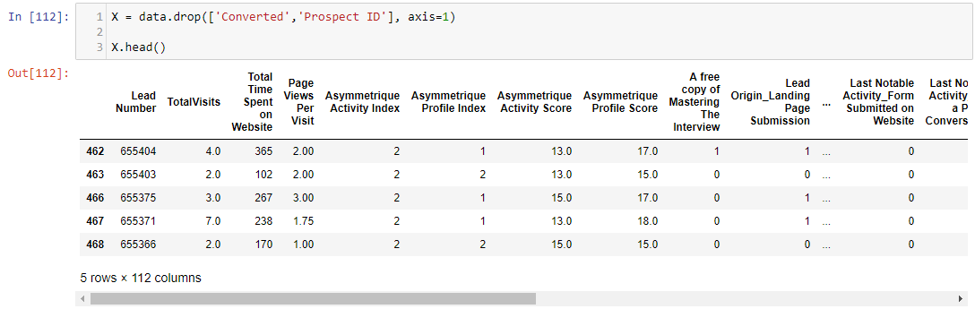
Feature Standardization and Split Data into Train and Test Sets
We have then applied the Feature Standardization- Normalized on continuous variables and splitting the data into train and test sets –
We have then defined the “Converted” variable for y, and then split the data into train and test data .

Slide 10
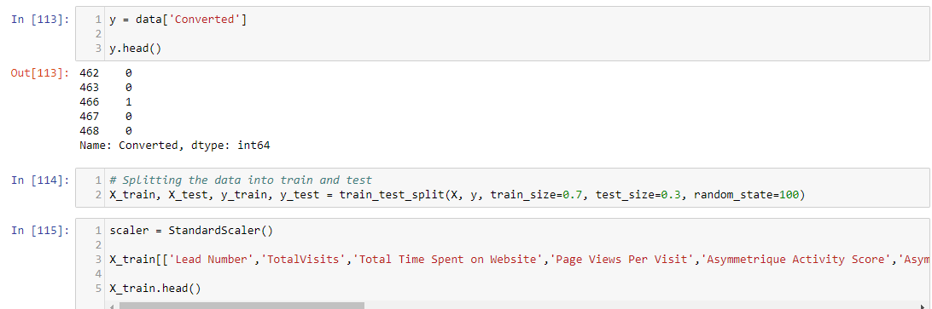
Feature Standardization and Split Data into Train and Test Sets

Slide 11
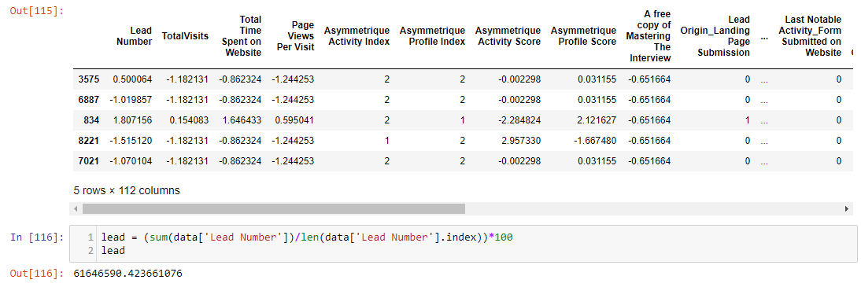
Feature Standardization and Split Data into Train and Test Sets
After executing the code mentioned in above slide , below results occurred.
We have then checked the Correlation matrix of variables using heatmap. Observed and analyzed the heatmap and identified the variables which are highly correlated, no correlation and netural correlation .

Slide 12
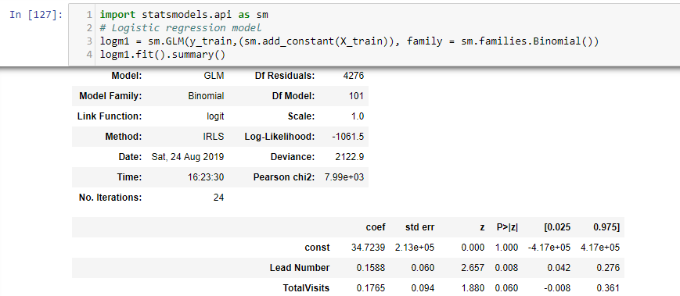
Model Building
We have initated modeling and executed the first Logistic Regression Model. We have observed the output of the model for different variables. The basic parameter like – Z , Std.err., P >|z|, and 0.025, 0.975 need to considered. The main parameter would be the Std.err, Z score and P value.
While looking into the results and parameters , we identified that many variables have values greater than 0.5 for P value , also some of the variables have the Std error which more than expected. Z score is also not fulfilling the criteria and goes beyond , so we would go to next step to refine the variables .

Slide 13
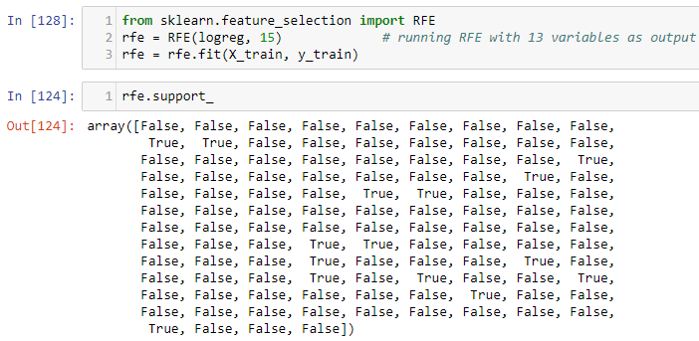
Feature Selection Using RFE
As we have found that the first model not giving the insights which we are expecting, hence we have initiating the RFE on variables for elimination purpose.
Defined the list of columns using Zip and defined.

Slide 14
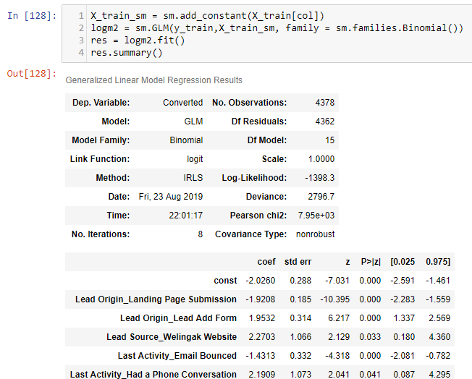
Assessing the model with StatsModels
After RFE , the list of columns which we defined in earlier stage need to assigned to the model, and execute the model, after executing the model the below result occur.

Slide 15
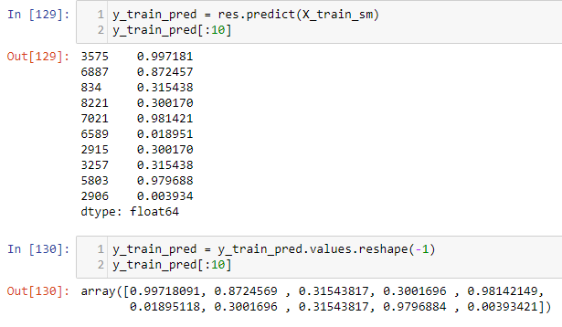
Predicated variables on the train set
We have executing the below code to find out the getting predicated variables on the train set. We have also checked the dimensions which resulted into the array list.

Slide 16
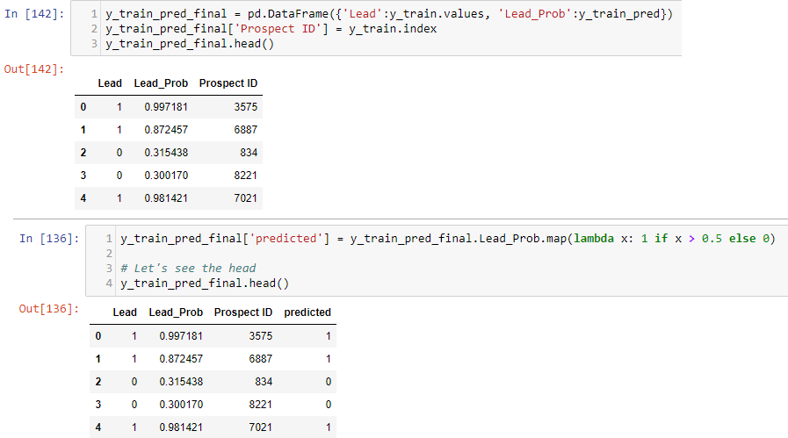
Predicated variables on the train set
We have then created a dataframe with the actual Lead flag and the predicted probabilities and Creating new column 'predicted' with 1 if lead_Prob > 0.5 else 0. The same handled in below code.

Slide 17
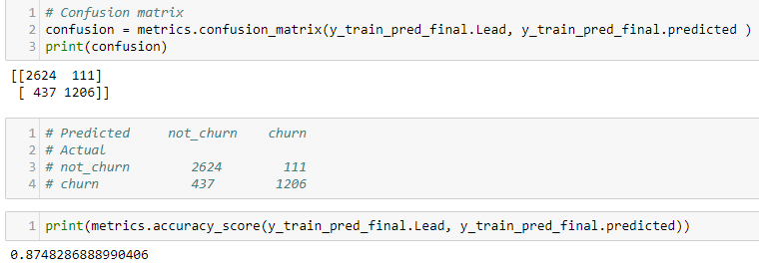
Confusion Matrix
We have identified five leads and calculated the probability ; we have now moved to next segment that is to define the confusion matrix.
We must define the confusion matrix on predicated train data set , which we already done.
So ideally confusion matrix on original variable and predicated , The result will be displayed below with the score of the accuracy.

Slide 18
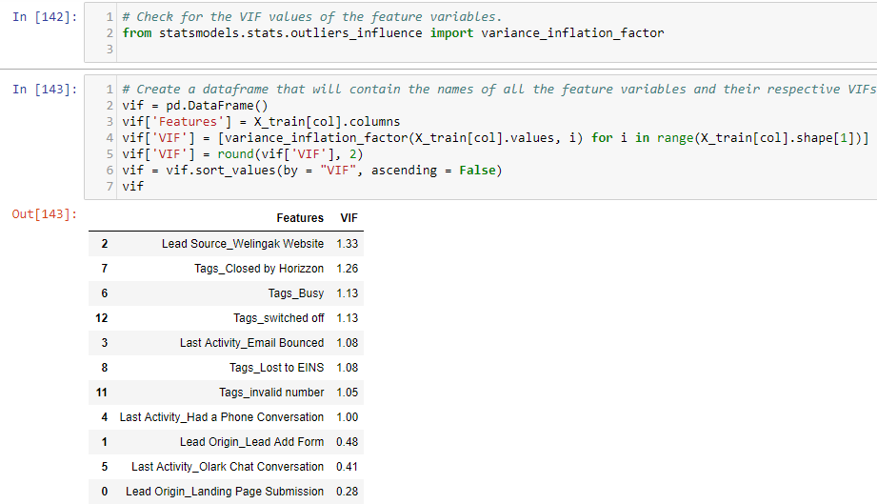
Applying VIFs
We applied VIF (Variance Inflation Factor) on the variables to identified the variance ratio of these variables. We need to confident that variance of these variables should not be more than 5 and same validated through below code.

Slide 19
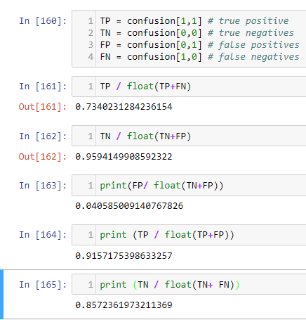
Metrics for simple accuracy
We have then set the define variable for true positive , false positive, true negative and false negative. After each matrix validated with the formula and check the simple accuracy.

Slide 20
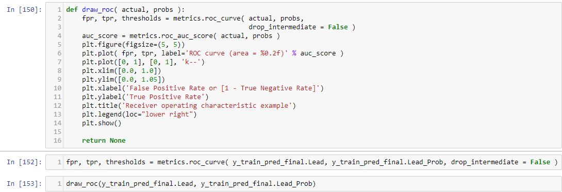
Plotting the ROC Curve
To identify the likelihood v/s probability against the variables , we have to initate to define the ROC which mainly considered actual, probabilities,false positive rate, true positive rate , threshold etc. need to apply on the train data set of the actual and predicated variable. The same handled in below code.
We have then plotted the ROC curve and analyze the curve and the data point of FPR and TPR.

Slide 21
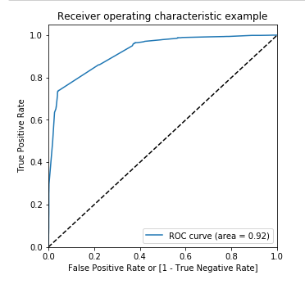
Plotting the ROC Curve
While looking into the ROC curve
We can find the TPR and FPR of actual v/s Predicated and the curve line is close to 1.0 and it curved near to 0 .7 so it almost covers 92% area.

Slide 22
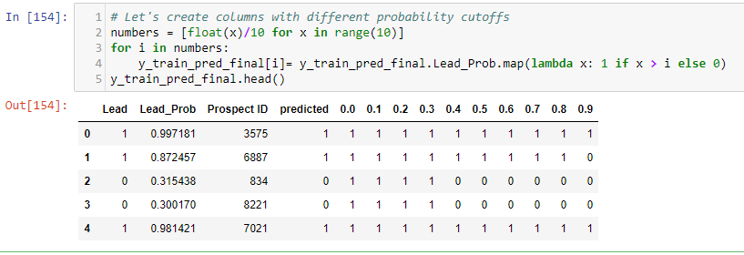
Optimal Cut-Off
The finding the optimal cut off point , we have considered the same predicated and actual on train data set and define the optimal number of range . So that the cut off will resulted into those many columns for each row. The same programmed below with the result –

Slide 23
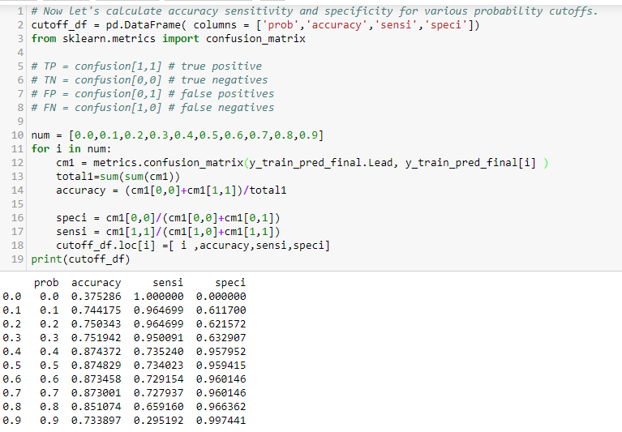
Calculate accuracy sensitivity and specificity for various probability cutoffs
We have now defined the columns for probability, accuracy, sensitivity, specificity . Considered the same train data set with the metrics of confusion matrix on probability cut off variables. After executing the same , below results gets generated.

Slide 24
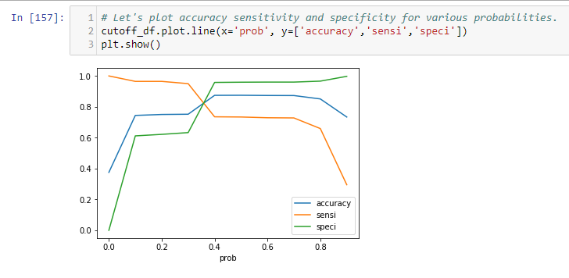
Calculate accuracy sensitivity and specificity for various probability cutoffs
Below plot describe the accuracy, sensitivity and specificity
While looking into the plot we can take inferences that on probability at point number 0.3 on X axis data point and we can find that closet value for accuracy, sensitivity and specificity.

Slide 25
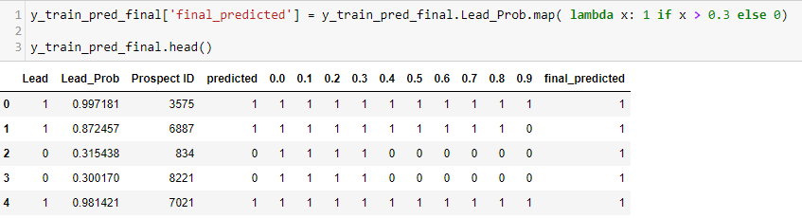
Cutoff Probability
We have now considered the 0.3 as cut-off point and same considered to define the probability and introduce the new column as ‘Final_Predicated’ where we can see the probability with most higher side Prospect ID showcased where the criteria mostly fulfilled business requirement, for this below program and result is showcases that Prospect_Id 3575,7021 is mostly correlate with each other , and majorly playing an important role to take business decision.
After this we have re-validated the accuracy of all parameters of confusion matrix. Same we have executed and found that numbers is matching with the above table.

Slide 26
Conclusion and Recommendation
As per the analysis and overall insights from the different plots , statistics, correlation matrix, confusion matrix, accuracy , specificity, sensitivity, ROC , Optimal cut off etc. The inferences from this study is that “Converted” is basically reply on the following columns –
TotalVisits,Asymmetrique Profile Index,Last Activity,Lead Source(google),X Education Forums,Total Time Spent on Website,Last Notable Activity_Modified
The above columns playing an important role of different their own parameters and the values within the variables of that. For example – when we have checked the Source with different variables and Source values with different variable combination , we have judged that Google value playing a most important role. In Similar pattern applicable for X Education Forum too. Again for this variable, we have considered different other variables like – Occuption, Specialization, Interest Area, What purpose client will opt for the course etc. and all these connected with each other . So when we choice for X Education Forum , we can easily segment the data and target to customer with different variations.
Also when we looked at the Site visited, time spent , pages visited gave us the good statistics figure , where we’ll able to analyze the interest area of client, and able to judge and target to customer.
So consideration of all these possible scenarios , above recommended high level variables would play an important role. There is again the dependency of other variable of these too, but when we digging and think business point of view , other sub variables also be part of these variables . Although these are the majorly recommended variables.

Slide 27
Thank You

